Slide 1
Welcome to
Our Sunday School
We’ll start at 9:07
visit OurSundaySchool.com for more about our class

Slide 2
Philemon, week 7 (pages 46-53)

Slide 3
Homework Review: Praying and Thanking God for OSS Members
Mila Archer | David Barber | Linda Decker | Jessica Miller
Tim Archer | Grace Barber | Dawn Fleming | Bruce Morgan
Chris Arnold | Margy Barber | Jim Fleming | Thesa Morgan
Kimberly Arnold | Josh Blair | Julie Fleming | Jessica Norris
Shanda Arter | Leslie Blair | Julia Gregg | Rachel Samsel
Zeke Arter | Gracie Coffey | Mitch Johnson | Darla Skinner
Jennifer Ayers | Jeff Coffey | Sherry Johnson | Doug Skinner
Matt Ayers | Lori Coffey | Sean McGarvey | Sondra Tweed
Bethany Barber | Bryan Decker | Trisha McGarvey

Slide 4
Speak, O Lord

Slide 5
Philemon, week 7 (pages 46-53)

Slide 6
Philemon 1:12–14
I am sending him back to you—I am sending my very own heart. I wanted to keep him with me, so that in my imprisonment for the gospel he might serve me in your place. But I didn’t want to do anything without your consent, so that your good deed might not be out of obligation, but of your own free will.

Slide 7
Dr. R. Scott Pace & Dr. Daniel L. Akin
Truth and timing are twin essentials in resolving conflict

Slide 8
Philemon, week 7 (pages 46-53)

Slide 9
Dr. Richard Melick

Slide 10
Dr. Richard Melick
Paul had no right to keep Onesimus; Onesimus needed to make restitution for his own sake; and the church needed the opportunity to see… Christianity at work

Slide 11
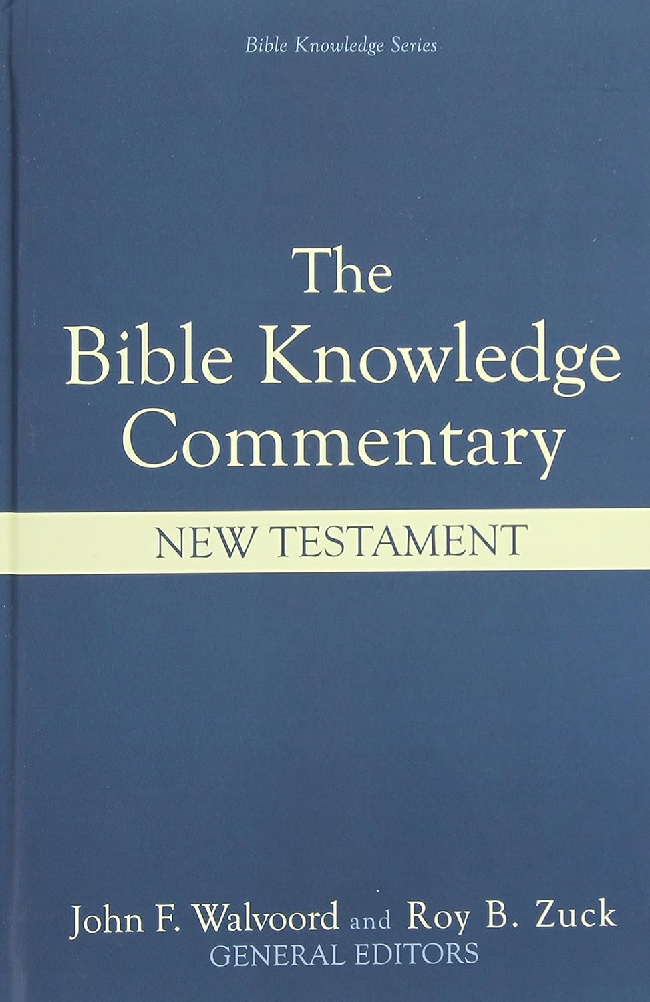
Dr. Edwin C. Deibler
Philemon would not have opportunity to think over Paul’s request before seeing Onesimus. Instead, facing Onesimus, the slave owner would need to decide right then.

Slide 12
Philemon, week 7 (pages 46-53)

Slide 13
Dr. Marvin Vincent
There is a hint that Onesimus, even as a slave, is rendering better service to the master whom he has wronged

Slide 14
Philemon, week 7 (pages 46-53)

Slide 15
Dr. N. T. Wright
As Paul gave up his rights (vv. 8–9), so he now gives up his preferences

Slide 16
Dr. Alan Thompson
Paul may also model what it means to live sacrificially, and this may in turn serve as an example for Philemon as Paul gets nearer to his request in verse 17

Slide 17
Philemon, week 7 (pages 46-53)

Slide 18
Dr. R. Scott Pace & Dr. Daniel L. Akin
The goal of this reconciliation is to do the right thing out of proper motivation. God is just as concerned, if not more so, with the heart as with the act.

Slide 19
Philemon, week 7 (pages 46-53)

Slide 20
Dr. Douglas J. Moo
The fellowship [Paul] enjoys with Philemon demands that Philemon be allowed to have final say in the matter of his slave Onesimus

Slide 21
Dr. Douglas J. Moo
Philemon had the legal right to make decisions regarding his slave. But Paul actually says nothing about legal obligations.

Slide 22
Dr. Douglas J. Moo
What he does say suggests rather that his concern is with the demands of Christian fellowship.

Slide 23
Dr. Douglas J. Moo
What is vital in this matter, Paul suggests, are not the demands of society but the demands of the “new society,” the community of faith.

Slide 24
Dr. Richard Melick
Proper ends must be brought about by proper means

Slide 25
Dr. R. Scott Pace & Dr. Daniel L. Akin
God is concerned with both the means and the end. We must be committed to doing the right thing in the right way for the right reasons.

Slide 26
Our Schedule (dv)
December 22 No Our Sunday School
December 29 No Our Sunday School
January 5 WWWWW&H for 2025
January 12 Preparing for 1:15–25
January 19 Philemon 1:15…

Slide 28
Prayer time
Write down your prayer requests (on the Weekly Update or in the comments
Lean in, engage, and pray for someone not with you
Be out of this room by 9:50
Go worship

